Slide 1
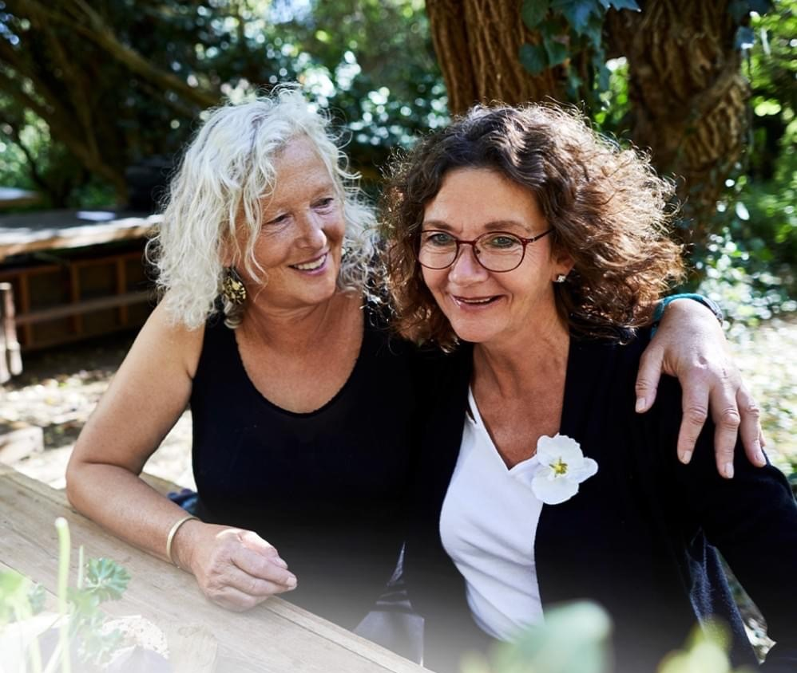
Free breast screens in Broken Hill 4-15 November 2024

